Slide 1

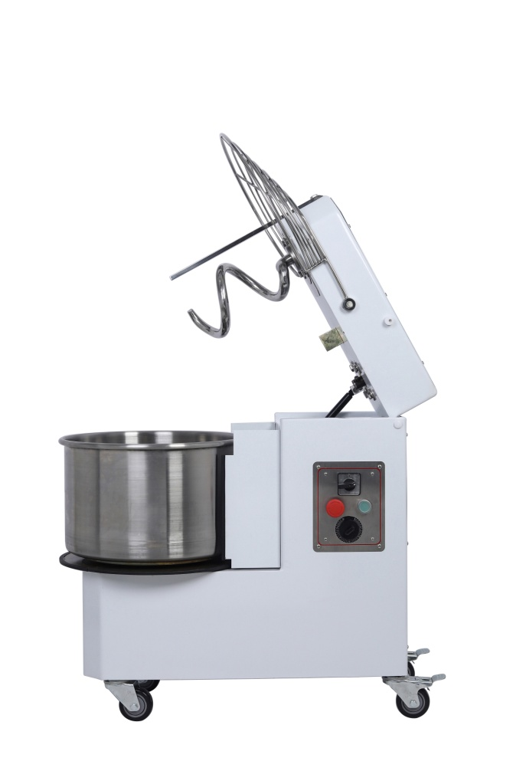
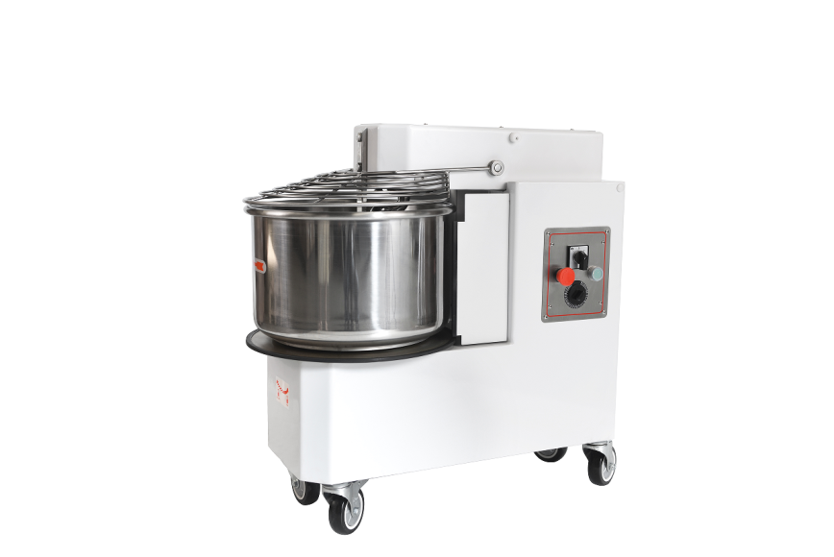


USER MANUAL
SPIRAL
MIXER
User Manual
Warning: Please read the user manual carefully before operating the machine

Slide 2
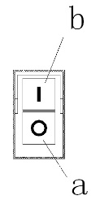
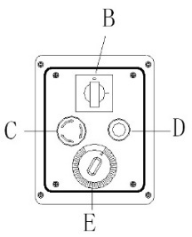
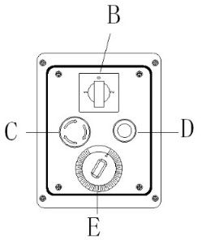
Warning
Switch
1/ Keep in order your working area. Disorder can cause dangerous accidents.
2/ Consider environmental conditions. Do not use the machine in humid, wet or badly lit environments, close to inflammable liquids or gas.
3/ Make sure water and heat sources are at safe distance.
4/ Keep away form children and non authorized personnel.
5/ Only utilize the machine with the correct voltage.
6/ Dress in adequate way. Do not wear hanging clothes or any items that can be caught in the machine. Use no-slip shoes. For hygiene and safety keep your hair tied back and wear protective gloves.
7/ Protect the cable. Do not pull the cable to extract the plug. Do not leave the cable near high temperatures, sharp objects, water or solvents.
8/ Avoid insecure positions. Find the best surface to ensure the machine is balanced.
9/ Take the plug out when the machine is not in use, before cleaning, maintenance and moving it.
10/ Do not use further extensions.
11/ Check that the machine is not damaged. Before using the machine carefully check that all security devices are working. Check that: the mobile parts are not blocked, there are not any parts damaged, all the parts have been set up correctly and all the conditions that could influence the regular functioning of the machine are in working order.
12/ Installing or repairing the machine by qualified personnel. Qualified people, using original spare parts, can only do the installation or repair. The non-compliance with these rules can represent danger for the user.
The machines are provided with the following operation and safety devices：
1/ Operating devices
1.1 / Sing-phase or Three-phase machines (LFM10 model):
a. Green button: Operating (Pict.1)
b. Red button: Stop
1.2/ Sing-phase or Three-phase machines (the rest of the models): ( Pict. 2 & Pict.3 )
B. Main switch
C. Red button: Emergency stop
D. Green button: Operating
E. Timer
Installation
1/ The machine must be installed in dry, drafty and bright environmental condition.
2/ Please position the machine on a flat and firm place; you can put it on a workbench whose height fits you, and leave a space around it of 50 cm for easier usage and cleaning.
3/ The machine is constructed to have IPX23 protection level.
4/ The electric network must be provided with an automatic differential switch having characteristics suitable to those of the machine, in which the opening distance between the contacts must be of at least 3 mm. Most of all it is necessary a good ground system. Verify that the electrical set-up corresponds with the numbers of the specification (7) found and on the small label at the back of the machine.
5/ The connections type Y of the machine with the electric network is made by means of an operation cable, which is provided with a plug only in the single-phase model. As far as the three-phase machines are concerned it is necessary to put together the cable and a normalized and polarized plug.
6/ The plug must be easily accessible, must not require any kind of movement. The cable from the machine to the wail plug must not be pulled tightly, also do not rest the machine on the cable.
Pict.1
Pict.2
Pict.3 (2 speed)

Slide 3
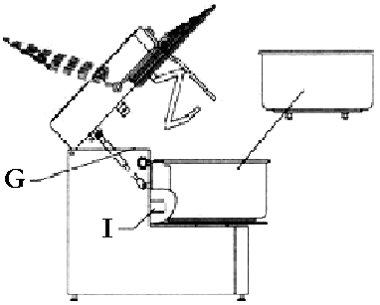

F
H
J
1/ the safety devices G, H, I, J can be installed only in the machines with raising top and removable bowl (LR series).
2/ The safety devices are applicable when:
- Raising the safety guard F (pict.4). The machine stops
- Raising the head (by means of the check pin H and/or taking off bowl the machine does not start)
F
H
J

Slide 4
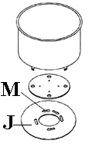
Usage of the machine
1/ After lifted up the safety guard F, pour ingredients to the bowl, close the safety guard, and press the operating switch a or D, with timer setting.
2/ The movement made by the hook, which is synchronized with the rotation of the bowl, gives an amalgamation of flour, water, salt, yeast and other eventual ingredients till you obtain a mixture of the consistence required.
3/ If necessary, in order to modify the characteristics and/or the consistence of the initial dough, pour the ingredients through the safety guard F.
4/ When work cycle is completed, leave the machine on hold, lift up the safety guard F to maximum opening, take the mixture out, proceed with cleaning of the machine following the indication at 5.1.
5/ Note: For the LR series, please stop the machine, unplug the machine, raise the safety guard F completely, pull the pin H as far as the head is un-lock, and raise the head by means of the little piston underneath. Then rotate clockwise the disk J as far as the bowl is unlocked, raise the bowl and take it out of the machine. Finally take off the dough.
6/ After cleaning, put the bowl back on, and make sure that the four pins underneath (pict.7) are correctly fixed in the four holes M of the machine; then lock the bowl rotating clockwise the disk J. Put the head down pushing it downwards as far as it is blocked by the pin H.
7/ Usage of the machine provided with timer
The timer is an electromechanical device that allows to program from 1 to 30 minutes
- The work-time of the machine by rotating the knob 0 in the desired position.
- Operate the machine following the instructions of 4.4.
- Once the set time is over, the timer stops the machine.
Important
Before taking off the dough, make sure the timer are in position “0”.
Pict.7

Slide 5
Maintenance
Warning:
1/ Before effecting any kind of maintenance or cleaning, you must cut off the power supply.
In any case of malfunctioning or damage of the machine, you must apply for authorized assistance from the manufacturer or dealer.
2/ The cleaning must be done every time the machine has been used following all the rules to prevent malfunctioning of the machine and for hygienic purposes.
Using a wooden or plastic palate first clean the residue of dough, then with a soft sponge and warm water accurately clean the bowl, the hook, the leading shaft and the safety guard, dry with kitchen paper.
Warning
3/ We recommend not to use any kind of chemical product abrasive or corrosive. Absolutely avoid using spraying water, sharp tools, rough or abrasive objects, metal/sponges etc., which can damage the surfaces and be dangerous from an hygienic point of view.
To maintain the efficiency and security of the machine it is necessary to proceed with periodical maintenance (every 6 months) of the following indications:
4/ Tensioning of the upper chain
The chain must be tensioned it, by checking it, it becomes loose or if the rotation of the hook is not constant: Unscrew the cover P, (Pict.9) loosen the screws Q, Pull the support of the hook R as far as the tension the chain is optimized. Lock the support R with the screws Q, Put the cover P on once more and fix it.
5/ Lubricating the chains
After unscrewing the fixing screws, take away the cover P and the back panels V, put reasonable amount of proper grease on the chains S &T (pict.8-9) , sufficient to lubricate all the links of the chain. Once this is done, mount the two panels and secure again with screws.
Pict.8
Pict.9

Slide 6
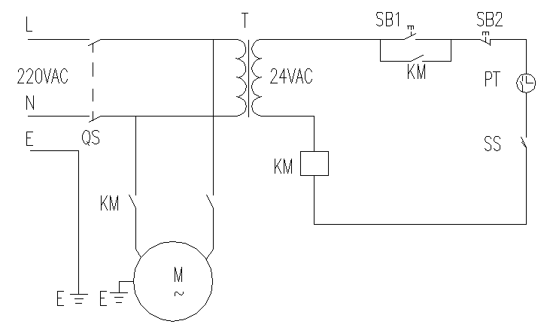
Specification Table
Model | HRM-20 | HRM-25 | HRM-30 | HRM-50 | HRM-60
Voltage(V) | 230 | 230 | 230 | 230 | 230
Cycle(Hz) | 50 | 50 | 50 | 50 | 50
Power(KW) | 1.5 | 1.5 | 1.5 | 1.5 | 1.5
Max Dough capacity(KG) | 10 | 16 | 20 | 30 | 35
Hook speed(rpm) | 98 | 98 | 98 | 98 | 98
Bowl speed(rpm) | 10 | 10 | 10 | 10 | 10
Dimension(mm) | 677x353x637 | 720x400x620 | 798x433x726 | 820x485x726 | 880x550x720
Slephase & single speeding
Electrical diagram
SS: Micro Switch
M: Motor SP: Sensor
QS: Main Switch
T: Transformer
KM: Contactor
PT: Timer
SB1: Start Button
SB2: Stop Button
Power Source Wire:L(red) N(blue)
Ground Wire E:(yellow-green)

Slide 7
illustration diagram
illustration Part list
Item | Description | Qty | Part no. |  | Remark
 |  |  | HRM-20 | HRM-25
1 | Safety guard | 1 | 17-003 | 22-005
2 | Bowl | 1 | 17-002 | 22-006
3 | Bowl Flange | 1 | 22-022 | 22-022
4 | Locking Flange | 1 | 17-005 | 22-008
5 | Transit ring | 3 | 22-053 | 22-053
6 | Bearing 6205 | 5 | 22-055 | 22-055
7 | Bearing support | 1 | 22-019 | 22-019
8 | Chain 126 | 1 | 22-041 | 22-041
9 | Chain wheel 72 | 1 | 22-042 | 22-042
10 | Support axle | 1 | 22-015 | 22-015
12 | Guard ring | 2 | 22-035 | 22-035
13 | Guard axle | 1 | 22-012 | 22-012
14 | Off-set ring | 1 | 22-028 | 22-028
19 | Chain wheel 15 | 1 | 22-043 | 22-043
20 | Spiral support | 1 | 22-020 | 22-020
22 | Bearing 6205 | 1 | 22-055 | 22-055

Slide 8
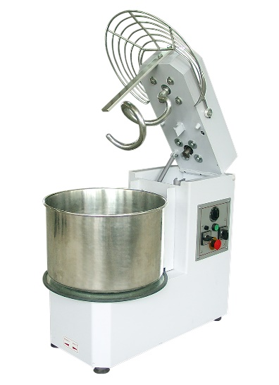
illustration Part list
Continue………
Item | Description | Qty | Part no. |  | Remark
 |  |  | HRM-20 | HRM-25
24 | Mixing Axle | 1 | 22-018 | 22-018
25 | Spiral | 1 | 17-001 | 22-004
27 | Cable fixer | 1 | 22-110 | 22-110
28 | Cable | 1 | 22-082/171/086 | 22-082/171/086 | LRM
 |  |  | 22-125 | 22-125 | LR
 |  |  | 22-098 | 22-098 | LR-2V
33 | Divider | 1 | 22-003 | 22-003
35 | Locker | 1 | 22-048 | 22-048
36 | Lock axle | 1 | 22-014 | 22-014
37 | lock spring | 1 | 22-049 | 22-049
39 | Side cover | 2 | 22-011 | 22-011
40 | Structure | 1 | 22-001 | 22-001
41 | foot | 4 | 22-033 | 22-033
42 | Rubber shoe | 4 | 22-034 | 22-034
43 | Wheel with stopper | 2 | 22-031 | 22-031
44 | Motor | 1 | 22-152 | 22-152 | LRM
 |  |  | 22-046 | 22-046 | LR
 |  |  | 22-153 | 22-153 | LR-2V
45 | Top cover | 1 | 22-009 | 22-009
46 | Head | 1 | 22-002 | 22-002
47 | Nylon ring | 2 | 22-029 | 22-029
49 | Air spring | 1 | 22-051 | 22-051
50 | Micro switch | 1 | 22-079 | 22-079
51 | Head axle | 1 | 22-013 | 22-013
52 | Nylon cover | 2 | 22-030 | 22-030
53 | Electrical box | 1 | 22-096 | 22-096
54 | Wheel | 2 | 22-032 | 22-032
55 | Contactor | 1 | 22-155 | 22-155 | LRM
 |  |  | 22-108 | 22-108 | LR
 |  |  | 22-108 | 22-108 | LR-2V
57 | Emergency stop | 1 | 22-099 | 22-099
58 | Transit ring | 1 | 22-093 | 22-093
61 | Gear box | 1 | 22-074 | 22-074
63 | Back cover | 1 | 22-010 | 22-010
64 | Transformer | 1 | 22-154 | 22-154 | LRM
 |  |  | 22-107 | 22-107 | LR
 |  |  | 22-107 | 22-107 | LR-2V

Slide 9
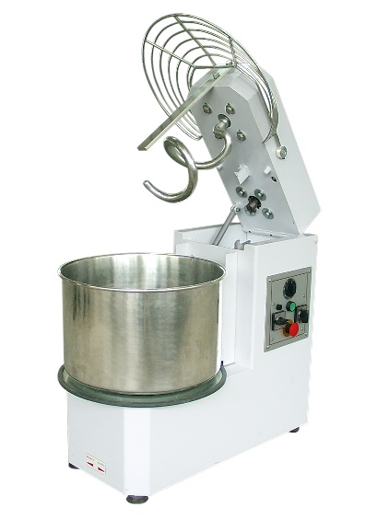
JR serial illustration Part list
Continue………
Item | Description | Qty | Part no. |  | Remark
 |  |  | HRM-20 | HRM-25
65 | Main Switch | 1 | 22-156 | 22-156 | LRM
 |  |  | 22-169 | 22-169 | LR
 |  |  | 22-157 | 22-157 | LR-2V
66 | Electrical panel | 1 | 22-097 | 22-097
67 | Start Switch | 1 | 22-100 | 22-100
68 | Timer | 1 | 22-103 | 22-103
69 | Chain | 1 | 22-040 | 22-056
70 | Chain wheel 29 | 1 | 22-045 | 22-045
71 | Bearing Connector | 1 | 22-021 | 22-021
75 | Connector axle | 1 | 22-017 | 22-017
77 | Connector key | 1 | 22-024 | 22-024
78 | Engager | 1 | 22-026 | 22-026
80 | Round bearing support | 1 | 22-054 | 22-054
81 | Wheel 14 | 1 | 22-044 | 22-044
83 | Transmission axles | 1 | 22-016 | 22-016
98 | Lever | 1 | 22-172 | 22-172
100 | Hook divider | 1 | 22-185 | 22-185
101 | Hook | 1 | 22-161 | 22-161
103 | Water shield | 1 | 22-187 | 22-187
104 | Adjusting screw | 1 | 22-192 | 22-192
105 | Auxiliary relay PCB | 1 | 22-281 | 22-281
106 | Hook washer |  | 22-193 | 22-193
110 | Electrical complete | 1 | 110-LRM | 110-LRM | LRM
 |  |  | 110-LR | 110-LR | LR
 |  |  | 110-LR-2V | 110-LR-2V | LR-2V
111 | Spiral support complete | 1 | 111-TR17/22 | 111-TR17/22

Slide 10
illustration Part list
Item | Description | Qty | Part no. |  |  | Remark
 |  |  | HRM-30 | HRM-50 | HRM-60
1 | Safety guard | 1 | 33-005 | 42-003 | 53-002
2 | Bowl | 1 | 33-006 | 42-002 | 53-001
3 | Bowl Flange | 1 | 22-022 | 22-022 | 22-022
4 | Locking Flange | 1 | 33-008 | 42-005 | 53-004
5 | Transit ring | 3 | 22-053 | 22-053 | 22-053
6 | Bearing 6205 | 5 | 22-055 | 22-055 | 22-055
7 | Bearing support | 1 | 22-019 | 22-019 | 22-019
8 | Chain 144 | 1 | 33-027 | 33-027 | 33-027
9 | Chain wheel 85 | 1 | 33-029 | 33-029 | 33-029
10 | Support axle | 1 | 22-015 | 22-015 | 22-015
11 | Screw | 4 | 22-062 | 22-062 | 22-062
12 | Guard ring | 2 | 22-035 | 22-035 | 22-035
13 | Guard axle | 1 | 33-012 | 33-012 | 33-012
14 | Off-set ring | 1 | 22-028 | 22-028 | 22-028
19 | Chain wheel 15 | 1 | 33-031 | 33-031 | 33-031
20 | Spiral support | 1 | 33-018 | 33-018 | 33-018
22 | Bearing 6205 | 1 | 33-036 | 33-036 | 33-036
24 | Mixing Axle | 1 | 33-017 | 33-017 | 33-017
25 | Spiral | 1 | 33-004 | 33-004 | 33-004
27 | Cable fixer | 1 | 22-110 | 22-110 | 22-110
33 | Divider | 1 | 33-003 | 42-001 | 53-006
35 | Locker | 1 | 22-048 | 22-048 | 22-048
36 | Lock axle | 1 | 33-014 | 33-014 | 33-014
37 | lock spring | 1 | 22-049 | 22-049 | 22-049
39 | Side cover | 2 | 33-011 | 42-008 | 53-007
41 | foot | 4 | 33-024 | 33-024 | 33-024
42 | Rubber shoe | 4 | 22-034 | 22-034 | 22-034
43 | Wheel with stopper | 2 | 33-022 | 33-022 | 33-022
44 | Motor | 1 | 33-048 | 42-006 | 42-006 | LRM
 |  |  | 33-033 | 33-033 | 33-033 | LR
 |  |  | 33-049 | 33-049 | 33-049 | LR-2V
45 | Top cover | 1 | 33-009 | 33-009 | 33-009
47 | Nylon ring | 3 | 22-029 | 22-029 | 22-029
49 | Air spring | 1 | 22-051 | 22-051 | 22-051
50 | Micro switch | 1 | 22-079 | 22-079 | 22-079
51 | Head axle | 1 | 33-013 | 33-013 | 33-013
52 | Nylon cover | 2 | 22-030 | 22-030 | 22-030
53 | Electrical box | 1 | 22-096 | 22-096 | 22-096
54 | Wheel | 2 | 33-023 | 33-023 | 33-023
55 | Contactor | 1 | 22-108 | 22-108 | 22-108
56 | Contractor | 1 | 22-109 | 22-109 | 22-109
57 | Emergency stop | 1 | 22-099 | 22-099 | 22-099
58 | Transit ring | 1 | 33-042 | 33-042 | 33-042

Slide 11

llustration Part list
Continue………
Item | Description | Qty | Part no. |  |  | Remark
 |  |  | HRM-30 | HRM-50 | HRM-60
59 | Fuse holder | 1 | 22-101 | 22-101 | 22-101
61 | Gear box | 1 | 33-034 | 33-034 | 33-034
63 | Back cover | 1 | 33-010 | 33-010 | 33-010
64 | Transformer | 1 | 22-107 | 22-107 | 22-107
65 | Main Switch | 1 | 22-169 | 22-169 | 22-169
66 | Electrical panel | 1 | 22-097 | 22-097 | 22-097
67 | Start Switch | 1 | 22-100 | 22-100 | 22-100
68 | Timer | 1 | 22-103 | 22-103 | 22-103
69 | Chain | 1 | 33-028 | 42-007 | 53-005
70 | Chain wheel 29 | 1 | 33-032 | 33-032 | 33-032
71 | Bearing Connector | 1 | 33-019 | 33-019 | 33-019
72 | Washer | 12 | 22-083 | 22-083 | 22-083
73 | Spring washer | 8 | 22-089 | 22-089 | 22-089
75 | Connector axle | 1 | 33-016 | 33-016 | 33-016
77 | Connector key | 1 | 22-024 | 22-024 | 22-024
78 | Engager | 1 | 33-020 | 33-020 | 33-020
80 | Round bearing support | 1 | 33-035 | 33-035 | 33-035
81 | Wheel 16 | 1 | 33-030 | 33-030 | 33-030
83 | Transmission axles | 1 | 33-015 | 33-015 | 33-015
98 | Lever | 1 | 22-072 | 22-072 | 22-072
100 | Hook divider | 1 | 22-185 | 22-185 | 22-185
101 | Hook | 1 | 22-161 | 22-161 | 22-161
103 | Water shield | 1 | 33-061 | 33-062 | 33-063
104 | Adjusting screw | 1 | 22-192 | 22-192 | 22-192
105 | Auxiliary relay PCB | 1 | 22-281 | 22-281 | 22-281
106 | Hook washer |  | 22-193 | 22-193 | 22-193
110 | Electrical complete | 1 | 110-TR | 110-TR | 110-TR
111 | Spiral support complete | 1 | 111-TR33/42/53 | 111-TR33/42/53 | 111-TR33/42/53

Slide 12



Trouble shooting
Trouble | Cause | Solution
The machine does not start | Lack of electric energy in the power supply The Emergency stop switch is locked The safety guard and/or the head are up The knob of the general switch is in position “0” The timer is in position “0” | Check the main switch, the plug, the wire. Rotate the button following the direction of the arrow. Close correctly both the safety guard and the head. Rotate the knob in position 1 Rotate the knob of the timer form 1 to 30 minutes
The hook turns inconstantly | The chain is loose | Stretch the chain following the instructions as 5.2
The dough barrel makes a loud noise | 1. The dough hook touches the bottom of the dough bucket; 2. The dough hook touches the upper cover; 3. Severe friction between the dough mixer shaft and the chain | 1. Remove the upper cover, adjust the screws of the hook, and check the friction part; 2. Adjust the progress or length of the chain to see if it is longer or shorter.
The dough barrel cannot be removed | Long-term non-use, rusted and fixed; | Need to use it frequently or occasionally start it;
The dough mask does not stop even when it is pulled into place, or does not work when it is not pulled up | The dough mixer start contact piece deviates | Remove the upper cover of the machine and push the contact piece to the appropriate position
The barrel runs in the opposite direction to the direction indicated by the arrow | Plug wiring error | Stop the machine, take out the 2-phase line, and change the position of the two-phase plug (for example: swap L1 and L2, and vice versa)
End of user manual

